Slide 1
Money Growth and Inflation (chapter 16 Mankiw book)

Slide 2
Inflation, Part 1
Inflation
  Increase in the overall level of prices
Deflation
  Decrease in the overall level of prices
Hyperinflation
  Extraordinarily high rate of inflation

Slide 3
Inflation, Part 2
2002 to 2012
  Prices rose at an average rate of 2.5% per year
The 1970s
  Prices rose by 7.8% per year
  The price level more than doubled over the decade

Slide 4
Inflation, Part 3
International data, 2012, inflation rate
  2.1% in the U.S
  Negative 0.1% in Japan
  5.1% in Russia
  9.3% in India
  21.1% in Venezuela
February 2008, Zimbabwe
  24,000 percent

Slide 5
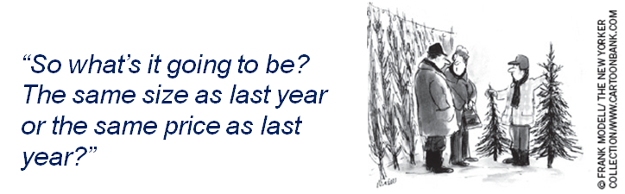
The Classical Theory of Inflation, Part 1
Classical theory of money
  Quantity theory of money
  Explain the long-run determinants of the price level
  Explain the inflation rate

Slide 6
Level of Prices; Value of Money
Inflation
  Economy-wide phenomenon
  Concerns the value of economy’s medium of exchange
Inflation: rise in the price level
  Lower value of money
  Each dollar buys a smaller quantity of goods and services

Slide 7
The Classical Theory of Inflation, Part 2
Money demand
  Reflects how much wealth people want to hold in liquid form
  Depends on
    Credit cards
    Availability of ATM machines
    Interest rate
    Average level of prices in economy
  Demand curve – downward sloping

Slide 8
The Classical Theory of Inflation, Part 3
Money supply
  Determined by the Fed and the banking system
  Supply curve is vertical
In the long run
  Overall level of prices adjust
    To the level at which the demand for money equals the supply

Slide 9
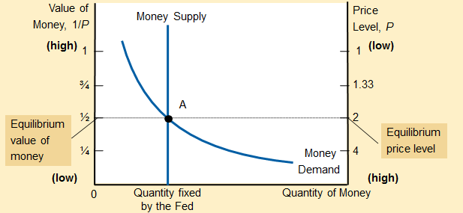
Figure 1
How the Supply and Demand for Money Determine the Equilibrium Price Level
The horizontal axis shows the quantity of money. The left vertical axis shows the value of money, and the right vertical axis shows the price level. The supply curve for money is vertical because the quantity of money supplied is fixed by the Fed. The demand curve for money is downward sloping because people want to hold a larger quantity of money when each dollar buys less. At the equilibrium, point A, the value of money (on the left axis) and the price level (on the right axis) have adjusted to bring the quantity of money supplied and the quantity of money demanded into balance.

Slide 10
Effects of a Monetary Injection, Part 1
Economy is in equilibrium
  If the Fed doubles the supply of money
    Prints bills
    Drops them on market
  Or the Fed: open-market purchase
  New equilibrium
    Supply curve shifts right
    Value of money decreases
    Price level increases

Slide 11
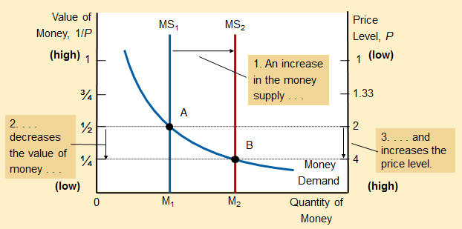
Figure 2
An Increase in the Money Supply
When the Fed increases the supply of money, the money supply curve shifts from MS₁ to MS₂. The value of money (on the left axis) and the price level (on the right axis) adjust to bring supply and demand back into balance. The equilibrium moves from point A to point B. Thus, when an increase in the money supply makes dollars more plentiful, the price level increases, making each dollar less valuable.

Slide 12
Effects of a Monetary Injection, Part 2
Quantity theory of money
  The quantity of money available in the economy determines (the value of money) the price level
  Growth rate in quantity of money available determines the inflation rate

Slide 13
Effects of a Monetary Injection, Part 3
Adjustment process
  Excess supply of money
  Increase in demand of goods and services
  Price of goods and services increases
  Increase in price level
  Increase in quantity of money demanded
  New equilibrium

Slide 14
Classical Dichotomy, Part 1
Nominal variables
  Variables measured in monetary units
    Dollar prices
Real variables
  Variables measured in physical units
    Relative prices, real wages, real interest rate
Classical dichotomy
  Theoretical separation of nominal and real variables

Slide 15
Classical Dichotomy, Part 2
Developments in the monetary system
  Influence nominal variables
  Irrelevant for explaining real variables
Monetary neutrality
  Changes in money supply don’t affect real variables
  Not completely realistic in short-run
  Correct in the long run

Slide 16
Velocity and the Quantity Equation, Part 1
Velocity of money (V)
  Rate at which money changes hands
V = (P × Y) / M
  P = price level (GDP deflator)
  Y = real GDP
  M = quantity of money

Slide 17
Velocity and the Quantity Equation, Part 2
Quantity equation: M × V = P × Y
    Quantity of money (M)
    Velocity of money (V)
    Dollar value of the economy’s output of goods and services (P × Y )
  Shows: an increase in quantity of money
    Must be reflected in:
      Price level must rise
      Quantity of output must rise
      Velocity of money must fall

Slide 18
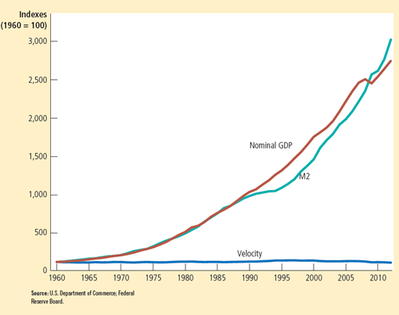
Figure 3
Nominal GDP, the Quantity of Money, and the Velocity of Money
This figure shows the nominal value of output as measured by nominal GDP, the quantity of money as measured by M2, and the velocity of money as measured by their ratio. For comparability, all three series have been scaled to equal 100 in 1960. Notice that nominal GDP and the quantity of money have grown dramatically over this period, while velocity has been relatively stable.

Slide 19
Quantity Theory of Money, Part 1
Velocity of money
  Relatively stable over time
Changes in quantity of money, M
  Proportionate changes in nominal value of output (P × Y)
Economy’s output of goods & services, Y
  Primarily determined by factor supplies
  And available production technology
  Money does not affect output

Slide 20
Quantity Theory of Money, Part 2
Change in money supply, M
  Induces proportional changes in the nominal value of output (P × Y)
    Reflected in changes in the price level (P)
When the central bank increases the money supply rapidly
  High rate of inflation

Slide 21
Money and prices during four hyperinflations, Part 1
Hyperinflation
  Inflation that exceeds 50% per month
  The price level increases more than a hundredfold over the course of a year
Data on hyperinflation
  Clear link between quantity of money and the price level

Slide 22
Money and prices during four hyperinflations, Part 2
Four classic hyperinflation, 1920s
  Austria, Hungary, Germany, and Poland
  Slope of the money line
    Rate at which the quantity of money was growing
  Slope of the price line: inflation rate
  The steeper the lines: the higher the rates of money growth or inflation
Prices rise when the government prints too much money

Slide 23
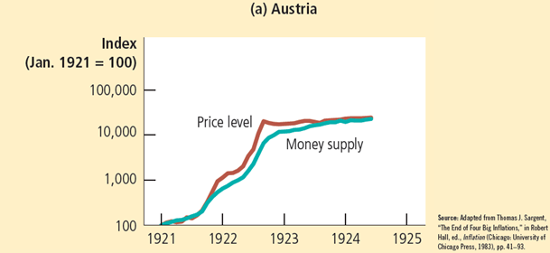
Figure 4, Part 1
Money and Prices during Four Hyperinflations
This figure shows the quantity of money and the price level during four hyperinflations. (Note that these variables are graphed on logarithmic scales. This means that equal vertical distances on the graph represent equal percentage changes in the variable.) In each case, the quantity of money and the price level move closely together. The strong association between these two variables is consistent with the quantity theory of money, which states that growth in the money supply is the primary cause of inflation.

Slide 24
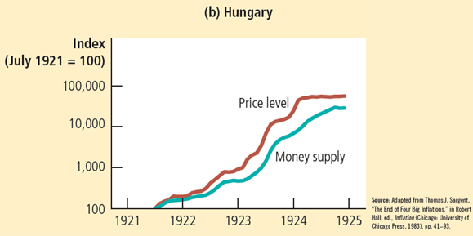
Figure 4, Part 2
Money and Prices during Four Hyperinflations
This figure shows the quantity of money and the price level during four hyperinflations. (Note that these variables are graphed on logarithmic scales. This means that equal vertical distances on the graph represent equal percentage changes in the variable.) In each case, the quantity of money and the price level move closely together. The strong association between these two variables is consistent with the quantity theory of money, which states that growth in the money supply is the primary cause of inflation.

Slide 25
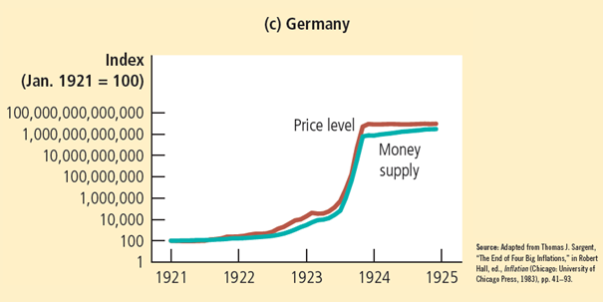
Figure 4, Part 3
Money and Prices during Four Hyperinflations
This figure shows the quantity of money and the price level during four hyperinflations. (Note that these variables are graphed on logarithmic scales. This means that equal vertical distances on the graph represent equal percentage changes in the variable.) In each case, the quantity of money and the price level move closely together. The strong association between these two variables is consistent with the quantity theory of money, which states that growth in the money supply is the primary cause of inflation.

Slide 26
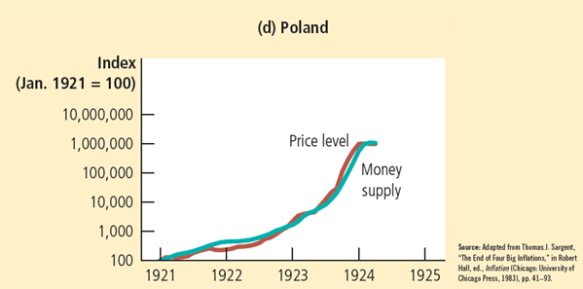
Figure 4, Part 4
Money and Prices during Four Hyperinflations
This figure shows the quantity of money and the price level during four hyperinflations. (Note that these variables are graphed on logarithmic scales. This means that equal vertical distances on the graph represent equal percentage changes in the variable.) In each case, the quantity of money and the price level move closely together. The strong association between these two variables is consistent with the quantity theory of money, which states that growth in the money supply is the primary cause of inflation.

Slide 27
The Inflation Tax
The inflation tax
  Revenue the government raises by creating (printing) money
  Tax on everyone who holds money
    When the government prints money
    The price level rises
    And the dollars in your wallet are less valuable

Slide 28
The Fisher Effect, Part 1
Principle of monetary neutrality
  An increase in the rate of money growth
  Raises the rate of inflation
  But does not affect any real variable
Real interest rate = Nominal interest rate – Inflation rate
Nominal interest rate = Real interest rate + Inflation rate

Slide 29
The Fisher Effect, Part 2
Fisher effect
  One-for-one adjustment of nominal interest rate to inflation rate
  When the Fed increases the rate of money growth
  Long-run result
    Higher inflation rate
    Higher nominal interest rate

Slide 30
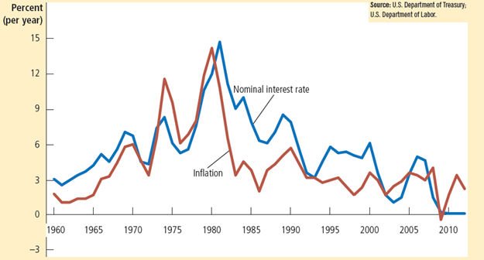
Figure 5
The Nominal Interest Rate and the Inflation Rate
This figure uses annual data since 1960 to show the nominal interest rate on three-month Treasury bills and the inflation rate as measured by the consumer price index. The close association between these two variables is evidence for the Fisher effect: When the inflation rate rises, so does the nominal interest rate.

Slide 31
The Costs of Inflation, Part 1
Inflation fallacy
  “Inflation robs people of the purchasing power of his hard-earned dollars”
When prices rise
  Buyers pay more
  Sellers get more
Inflation does not in itself reduce people’s real purchasing power

Slide 32
Read till page no 353 of this chapter Mankiw

